Slide 1
Supervised vs. Unsupervised Learning
Two learning problems: Supervised and Unsupervised
Supervised Learning:
Both the predictors, X_{i}, and the response, Y_{i}, are observed.
Learning is guided by Y variable.
Example: Linear Regression.
Primary focus is supervised learning.
Notes:
(CLICK)We can divide all learning problems into Supervised and Unsupervised situations. (CLICK) In Supervised learning, we have both Y and X variables. (CLICK) The learning process is guided or supervised by the presence of Y variable. (CLICK) For example, linear regression is supervised learning. (CLICK) Most of this course is about supervised learning. We will cover only a few topics from unsupervised learning.

Slide 2
Supervised vs. Unsupervised Learning
Unsupervised Learning:
In this situation only the X_{i}’s are observed.
No Y variable.
A common unsupervised learning is clustering.
Example: Market Segmentation - divide potential customers into groups.
Notes:
(CLICK) In Unsupervised learning, we have only X variables. (CLICK)There is no response variable. (CLICK) Clustering is arguably the most famous unsupervised learning in practice. (CLICK) A common example is market segmentation where we try to divide potential customers into groups based on their characteristics. (CLICK) Like I mentioned, the primary focus is on supervised learning; we will cover only a few topics from unsupervised learning.

Slide 3
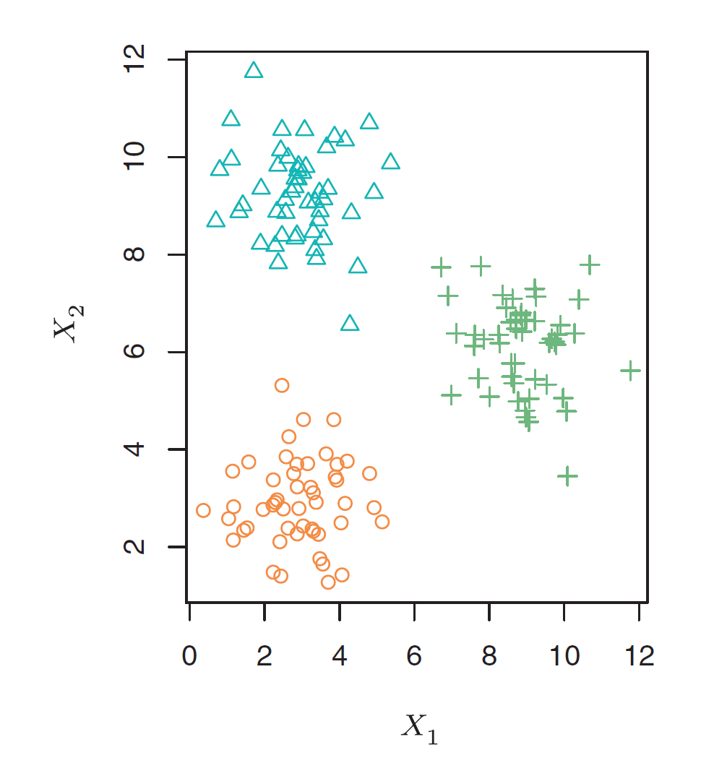
Clustering Examples
Notes:
(CLICK) Here is a simple Clustering example with two (CLICK) X variables. As we noted earlier, there is no Y variable. (CLICK) (CLICK) In this example, we have formed three clusters. These clusters are quite apparent. (CLICK) (CLICK) Here is another example with two X variables. (CLICK) We have formed three clusters for this data as well. In this example, the separation is not apparent. Without using a Clustering algorithm, it is hard to separate the data. We will learn clustering in other videos.

